Slide 1
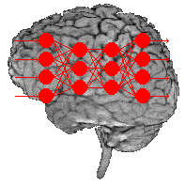
Artificial Neural Networks

Slide 2
Artificial Neural Network
Computational models inspired by the human brain: Algorithms that try to mimic the brain.
  Massively parallel, distributed system, made up of simple processing units (neurons / perceptron )
  Synaptic connection strengths among neurons are used to store the acquired knowledge.
  Knowledge is acquired by the network from its environment through a learning process

Slide 3
Why Artificial Neural Networks?
There are two basic reasons why we are interested in building artificial neural networks (ANNs):
Technical viewpoint
Biological viewpoint

Slide 4
Why Artificial Neural Networks?
Technical viewpoint
ANNs are useful for solving complex computational problems that require massively parallel and adaptive processing. This includes:
Pattern Recognition & Classification: ANNs excel at recognizing patterns in data, making them ideal for character recognition (e.g., handwriting recognition, Optical Character Recognition (OCR)).
Prediction & Forecasting: ANNs can be used to predict future states of a system, such as stock market trends, weather forecasting, or equipment failure predictions.
High-Dimensional Data Processing: Unlike traditional algorithms, ANNs can handle large amounts of unstructured data (images, speech, text) in real-time applications.
Parallel Processing Efficiency: Unlike traditional serial computing, ANNs use multiple interconnected neurons, enabling fast and simultaneous processing of large datasets.

Slide 5
Why Artificial Neural Networks?
Biological viewpoint
ANNs are inspired by the functioning of the human brain. The goal is to replicate or simulate components of biological neural networks, leading to:
Understanding Brain Functions: By modeling artificial neurons, researchers can gain insights into how real neurons in the human (or animal) brain process information and learn.
Cognitive & Neuroscientific Research: ANNs help neuroscientists understand cognitive processes like learning, memory, and decision-making.
Brain-Computer Interfaces (BCIs): ANN-based models play a role in prosthetics, neural signal decoding, and mind-controlled devices.
Simulation of Learning Mechanisms: ANNs mimic human learning and adaptability, helping in the development of intelligent systems.

Slide 6
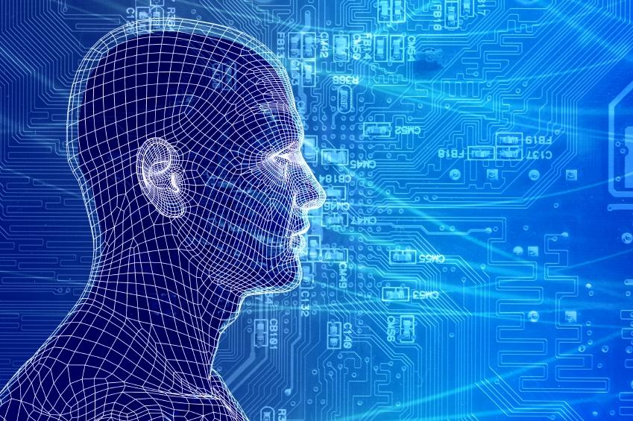
How do our brains work?
    The Brain is A massively parallel information processing system.
    Our brains are a huge network of processing elements. A typical brain contains a network of 10¹¹ neurons where each connected, on average, to 10⁴ others.

Slide 7
How do our brains work?
Information is transmitted as a series of electric impulses, so-called spikes.
The frequency and phase of these spikes encodes the information.
In biological systems, one neuron can be connected to as many as 10,0000 other neurons.
Usually, a neuron receives its information from other neurons in a confined area, its so-called receptive field.

Slide 8
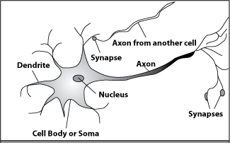
How do our brains work?
Single Neuron: A processing element
Dendrites: Input
Cell body: Processor
Synaptic: Link
Axon: Output

Slide 9
How do our brains work?
A processing element
A neuron is connected to other neurons through about 10,0000 synapses

Slide 10
How do our brains work?
A processing element
A neuron receives input from other neurons. Inputs are combined.

Slide 11
How do our brains work?
A processing element
Once input exceeds a critical level, the neuron discharges a spike ‐ an electrical pulse that travels from the body, down the axon, to the next neuron(s)

Slide 12
How do our brains work?
A processing element
The axon endings almost touch the dendrites or cell body of the next neuron.

Slide 13
How do our brains work?
A processing element
Transmission of an electrical signal from one neuron to the next is effected by neurotransmitters.

Slide 14
How do our brains work?
A processing element
Neurotransmitters are chemicals which are released from the first neuron and which bind to the
Second.

Slide 15
How do our brains work?
A processing element
This link is called a synapse. The strength of the signal that reaches the next neuron depends on factors such as the amount of neurotransmitter available.

Slide 16
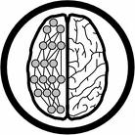
How do ANNs work?
An artificial neural network (ANN) is either a hardware implementation or a computer program which strives to simulate the information processing capabilities of its biological exemplar. ANNs are typically composed of a great number of interconnected artificial neurons. The artificial neurons are simplified models of their biological counterparts.
ANN is a technique for solving problems by constructing software that works like our brains.

Slide 17
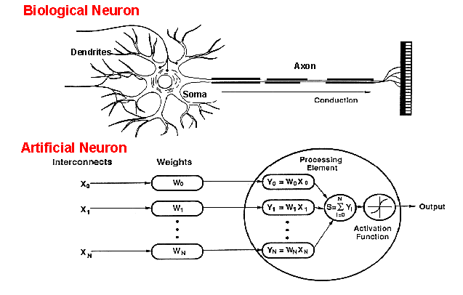
How do ANNs work?
An artificial neuron is an imitation of a human neuron

Slide 18
How do ANNs work?
Input
xm
. . . . . . . . . . . .
x2
x1
Processing
∑
∑= X₁+X₂ + ….+X_{m} =y
Output
y

Slide 19

How do ANNs work?
Not all inputs are equal
xm
. . . . . . . . . . . .
x2
x1
Input
w_{m}
w₂
w₁
weights
. . . . .
Processing
∑
∑= X₁w₁+X₂w₂ + ….+X_{m}w_{m} =y
Output
y

Slide 20

How do ANNs work?
The signal is not passed down to the
next neuron verbatim
xm
. . . . . . . . . . . .
x2
x1
Input
w_{m}
w₂
w₁
weights
. . . . .
Processing
∑
Transfer Function (Activation Function)
f(v_{k})
Output
y

Slide 21
History
late-1800's
  In the late 1800s, scientists studying the human brain and nervous system proposed that intelligence arises from interconnected biological neurons. At this stage, neural networks were conceptual models, not computational systems, because computers did not yet exist.
1960's and 70's – Simple neural networks appear
  With the advent of early computers, researchers began developing simple artificial neural networks, most notably the perceptron. These models could perform basic pattern recognition and classification tasks. However, they were limited to linearly separable problems.
  Neural networks fell out of favor in the late 1960s and 1970s because: A single-layer perceptron was not powerful enough to model complex patterns.
  There were no effective training algorithms for multilayer neural networks. Research showed theoretical limitations of perceptrons, leading to reduced funding and interest. This is called AI winter.
1986 – Backpropagation algorithm appears
  the backpropagation algorithm was introduced and popularized, providing an efficient method to train multilayer neural networks by adjusting weights using gradient descent.
  Neural networks regained popularity due to their ability to solve non-linear and complex problems.
  Researchers successfully applied them to speech recognition, image processing, and pattern recognition.

Slide 22
Applications of ANNs
Pattern recognition: ANNs can identify and classify patterns in data, making them highly useful in image processing, speech recognition, and handwriting recognition.
Examples:
Image Recognition: ANNs are used in facial recognition, medical image analysis (tumor detection), and object recognition in autonomous vehicles.
Speech Recognition: Voice assistants like Siri, Google Assistant, and Alexa use ANNs to understand spoken commands.
Handwriting Recognition: ANNs help convert handwritten text into digital text, used in postal services and banking (check processing).

Slide 23
Applications of ANNs
Function Approximation: ANNs can approximate complex mathematical functions based on input-output data, making them useful for predictive modeling and simulations.
Examples:
  Stock Market Prediction: ANNs analyze historical data to predict future stock trends.
  Weather Forecasting: Neural networks help predict weather conditions based on historical climate data.
  Engineering & Control Systems: Used in robotics and industrial automation to model complex physical systems.

Slide 24
Applications of ANNs
Associative Memory: ANNs can store and recall information based on learned associations, similar to how the human brain remembers related concepts.
Examples:
  Content Recommendation: Streaming platforms like Netflix and Spotify use ANNs to associate user preferences with relevant content.
  Medical Diagnosis: ANNs store patterns of symptoms and diseases to assist doctors in diagnosing illnesses.
  Cognitive Computing: Used in AI systems to mimic human memory, like recognizing faces or recalling user preferences in smart assistants.

Slide 25
Properties
Inputs are flexible
  any real values
  Highly correlated or independent
Target function may be discrete-valued, real-valued, or vectors of discrete or real values
  Outputs are real numbers between 0 and 1
Resistant to errors in the training data
Long training time
Fast evaluation
The function produced can be difficult for humans to interpret

Slide 26
When to consider neural networks
Input is high-dimensional discrete or raw-valued
Output is discrete or real-valued
Output is a vector of values
Possibly noisy data
Form of target function is unknown
Human readability of the result is not important
Examples:
Speech phoneme recognition
Image classification
Financial prediction

Slide 27
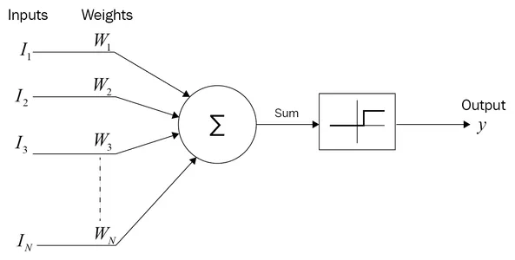
McCulloch–Pitts (MCP) Neuron
The McCulloch–Pitts neuron model (more commonly called the MCP model) is one of the earliest mathematical models of a single artificial neuron, proposed in 1943 by McCulloch and Pitts. It explains how a neuron makes a binary decision: fire or not fire.
A neuron fires only if the total input signal crosses a fixed threshold
It is a binary decision-making unit, not a learning unit.

Slide 28
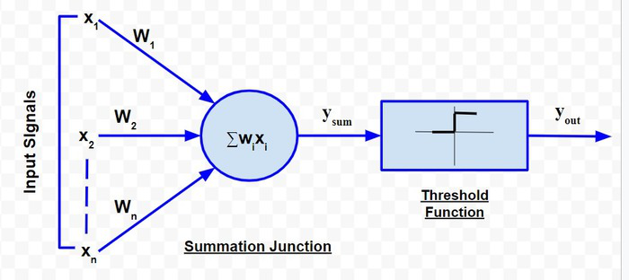
McCulloch–Pitts (MCP) Neuron
Basic Assumptions of MCP Model
  The MCP neuron works under these assumptions:
  Inputs are binary → 0 or 1
  Output is binary → 0 or 1
  Weights are fixed
  Uses a hard threshold (step) function
  No learning, no backpropagation
Structure of MCP Neuron
Components
  Inputs: x1, x2,...,xn
  Weights: w1,w2,...,wn
  Threshold: θ
  Activation function: Step function
  Output: y

Slide 29
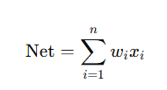

McCulloch–Pitts (MCP) Neuron
Mathematical Model
    Net Input
Activation Function
MCP neuron does NOT learn, We manually choose weights and threshold to implement logic.

Slide 30

IMPLEMENTATION OF LOGIC GATES USING MCP NEURON
AND Gate using MCP Neuron
Step 1: AND Gate Truth Table
Step 2: Choose Weights and Threshold
  w1=1
  w2=1
  θ=2 Only when both inputs are 1, sum = 2.
Step 3: Apply MCP Equation
x₁ | x₂ | AND
0 | 0 | 0
0 | 1 | 0
1 | 0 | 0
1 | 1 | 1
Step 4: Verification of AND Gate
x₁ | x₂ | Net | Output
0 | 0 | 0 | 0
0 | 1 | 1 | 0
1 | 0 | 1 | 0
1 | 1 | 2 | 1

Slide 31
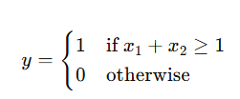
IMPLEMENTATION OF LOGIC GATES USING MCP NEURON
OR Gate using MCP Neuron
Step 1: OR Gate Truth Table
Step 2: Choose Weights and Threshold
  w1=1
  w2=1
  θ=1
Step 3: Apply MCP Equation
x₁ | x₂ | OR
0 | 0 | 0
0 | 1 | 1
1 | 0 | 1
1 | 1 | 1
Step 4: Verification of AND Gate
x₁ | x₂ | Net | Output
0 | 0 | 0 | 0
0 | 1 | 1 | 1
1 | 0 | 1 | 1
1 | 1 | 2 | 1

Slide 32

IMPLEMENTATION OF LOGIC GATES USING MCP NEURON
NOT Gate using MCP Neuron
Step 1: NOT Gate Truth Table
Step 2: Choose Weights and Threshold
  w1=-1
  θ=0
Step 3: Apply MCP Equation
x | NOT x
0 | 1
1 | 0
Step 4: Verification of AND Gate
x | Net | Output
0 | 0 | 1
1 | -1 | 0
The McCulloch–Pitts neuron is a binary threshold model that produces output based on a fixed threshold. It does not support learning or backpropagation. By appropriately selecting weights and threshold values, the MCP neuron can implement basic logic gates such as AND, OR, and NOT.

Slide 33
Limitations of McCulloch–Pitts (MCP) Neuron
1. No Learning Capability
  Weights are fixed and manually assigned
  No weight update rule
  Cannot improve performance from data
2. Binary Inputs and Outputs Only
  Inputs must be 0 or 1
  Output is strictly 0 or 1
  Cannot handle continuous or real-valued data
3. Hard Threshold Activation
  Uses step (threshold) function
  Not differentiable
  Gradient-based optimization is impossible
4. Cannot Solve Non-Linear Problems
  Works only for linearly separable functions
  Fails for XOR problem
  Single neuron is insufficient for complex decision boundaries
5. No Backpropagation Support
  No error feedback mechanism
  Cannot adjust weights based on output error
6. Too Simple for Real-World Applications
  Cannot model uncertainty or noise
  Not suitable for image, speech, or text data
  Purely a theoretical model
“MCP neuron can compute logic, but it cannot learn from data.”

Slide 34
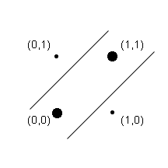
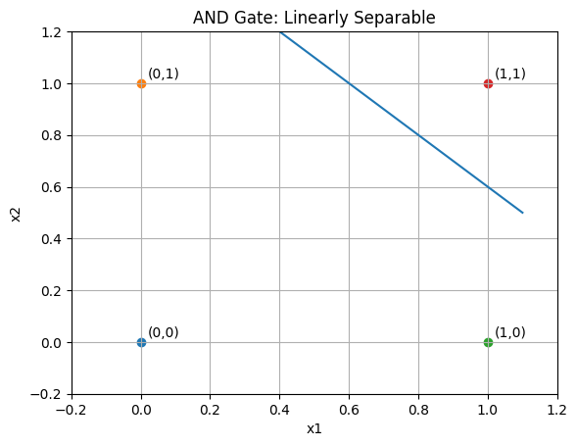
Why MCP Neuron Fails for XOR Problem?
What is XOR (Exclusive OR)?
Why MCP Can Solve AND / OR but Not XOR?
MCP neuron uses: Fixed weights, Single threshold, Linear decision rule.
This means: MCP neuron can separate data only using a straight line.
Linear Separability (Very Important Concept):
A problem is linearly separable if, A single straight line can separate output 1 and output 0 cases. AND / OR are linearly separable.
x₁ | x₂ | XOR
0 | 0 | 0
0 | 1 | 1
1 | 0 | 1
1 | 1 | 0
Output is 1 only when inputs are different.

Slide 35
Why MCP Neuron Fails for XOR Problem?
What is XOR (Exclusive OR)?
Why MCP Can Solve AND / OR but Not XOR?
MCP neuron uses: Fixed weights, Single threshold, Linear decision rule.
This means: MCP neuron can separate data only using a straight line.
Linear Separability (Very Important Concept):
A problem is linearly separable if, A single straight line can separate output 1 and output 0 cases. AND / OR are linearly separable.
XOR: Not linearly separable, No single straight line can separate the classes, MCP fails
x₁ | x₂ | XOR
0 | 0 | 0
0 | 1 | 1
1 | 0 | 1
1 | 1 | 0
Output is 1 only when inputs are different.

Slide 36
Why MCP Neuron Fails for XOR Problem?
Mathematical Proof of Failure
Let MCP neuron have:
  Inputs: x1,x2
  Weights: w1,w2
  Threshold: θ
Conditions required for XOR = 1
From truth table:
For (0,1) → output = 1
                w2≥θ
      For (1,0) → output = 1
                w1≥θ
Conditions required for XOR = 0
From truth table:
For (0,0) → output = 0
                0<θ
      For (1,1) → output = 0
                w1​+w2​<θ
The MCP neuron fails to solve the XOR problem because XOR is not linearly separable.
Since MCP uses a single linear threshold function with fixed weights, no combination of weights and threshold can correctly classify XOR inputs.
Contradiction: From above:
w1≥θ & w2≥θ
Adding both: w1+w2≥2θ
But XOR requires: w1+w2<θ
Contradiction!
No values of w1,w2,θ can satisfy all conditions.
x₁ | x₂ | XOR
0 | 0 | 0
0 | 1 | 1
1 | 0 | 1
1 | 1 | 0

Slide 37
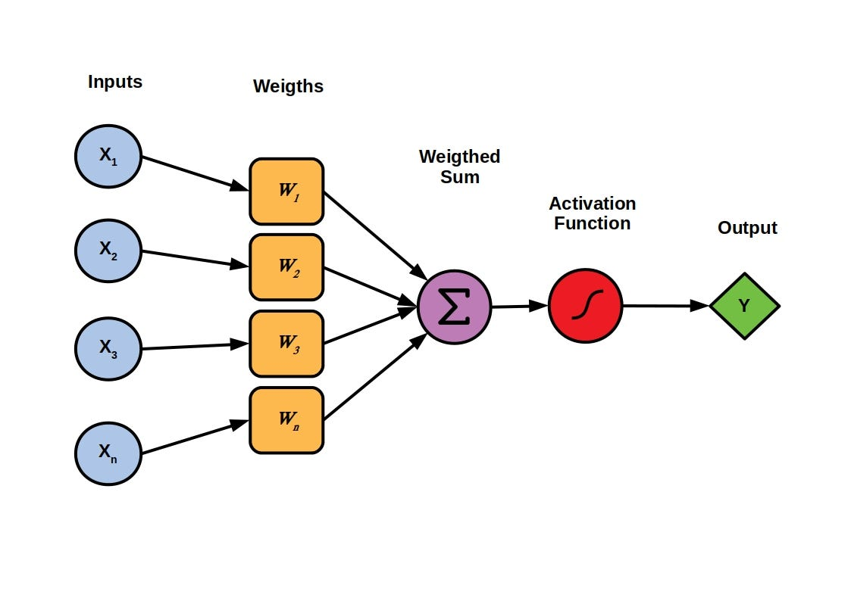
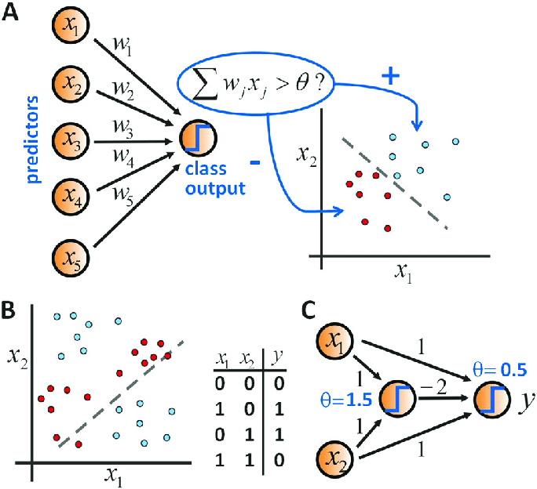
What is a Perceptron?
The Perceptron is an improved artificial neuron model proposed in 1957 by Frank Rosenblatt.
Perceptron can learn from data by automatically adjusting its weights.
A perceptron is a binary classifier that learns a decision boundary by updating weights based on errors.
Unlike MCP: Weights are not fixed Weights are learned from examples

Slide 38
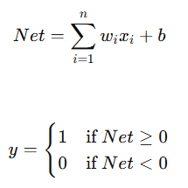
What is a Perceptron?
Structure of a Perceptron
A perceptron consists of:
  Inputs: x1,x2,…,xn
  Weights: w1,w2,…,wn
  Bias: b
  Activation function: Step function
  Output: y∈ {0,1}
  Bias replaces the threshold used in MCP.
Mathematical Model of Perceptron
Net Input
Activation Function

Slide 39
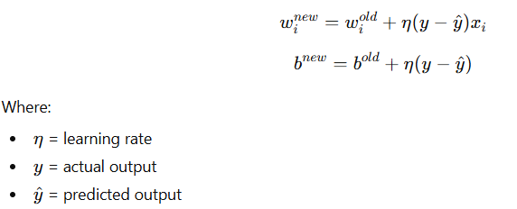
What is a Perceptron?
Learning in Perceptron
Perceptron Learning Rule
If prediction is correct → no change
If wrong → weights are corrected
Learning continues until errors reduce

Slide 40
Perceptron Capabilities and Limitations
Capabilities
Learns from Training Data
  Uses labeled examples to improve performance
  Modifies its behavior based on past errors
Automatic Weight Adjustment
  Weights are updated using an error-correction learning rule
  No manual tuning of weights is required
Solves Linearly Separable Problems
  Can correctly classify problems where classes can be separated by a straight line
  Successfully implements logic functions like AND and OR
Foundation of Multi-Layer Neural Networks
  Serves as the basic building block of Multi-Layer Perceptrons (MLPs)
  Forms the conceptual basis for deep neural networks
Limitations
Uses Hard Threshold (Step) Activation
  Activation function is not differentiable
  Prevents use of gradient-based learning methods
Cannot Solve Non-Linearly Separable Problems
  Fails for problems like XOR
  Single perceptron is insufficient for complex patterns
Restricted to Linear Decision Boundaries
  Produces only straight-line separation in input space
  Cannot model curved or complex decision regions

Slide 41
Difference Between MCP and Perceptron
Feature | MCP Neuron | Perceptron
Inventor | McCulloch & Pitts (1943) | Rosenblatt (1957)
Learning ability | No learning | Learns from data
Weights | Fixed | Adjustable
Bias / Threshold | Threshold ((\theta)) | Bias ((b))
Weight update rule | Not present | Perceptron learning rule
Training data | Not required | Required
Error correction | No | Yes
XOR problem | Cannot solve | Cannot solve
Purpose | Logical computation | Binary classification

Slide 42

Artificial Neuron — General Concept
An artificial neuron is a general mathematical model of a biological neuron.
A perceptron is a specific type of artificial neuron with a particular learning rule and activation function.
An artificial neuron is the basic building block of neural networks. It mimics how a biological neuron processes signals.
An artificial neuron Takes multiple inputs, Multiplies them with weights, Adds bias, Passes result through an activation function.
Mathematically:
Where: xi​ → inputs
  wi→ weights
  b→ bias
  f → activation function where Activation functions can be:Linear, Sigmoid, ReLU, Tanh, Softmax, etc.
This flexibility makes artificial neurons usable in modern deep learning.

Slide 43

Perceptron — Specific Model
The perceptron, introduced by Frank Rosenblatt (1957), is the simplest form of artificial neuron.
Uses weighted sum of inputs
Uses a step (threshold) activation function
Designed mainly for binary classification
Perceptron output:
Where:
Output is only 0 or 1
Decision boundary is linear

Slide 44
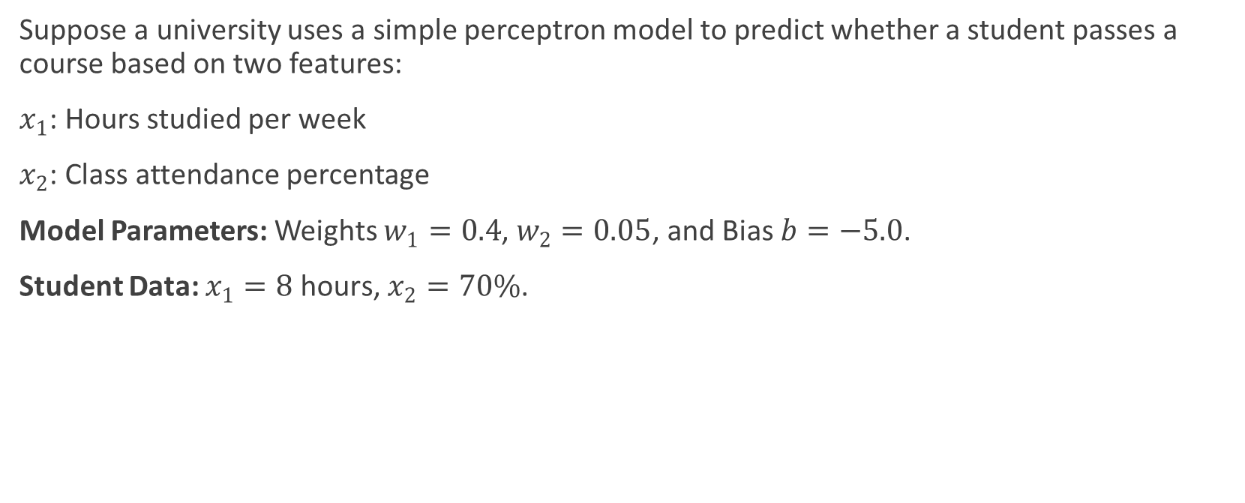
Real-World Conceptual Example: Pass/Fail Decision
Suppose a university uses a simple perceptron model to predict whether a student passes a course based on two features:
$x_{1}$: Hours studied per week
$x_{2}$: Class attendance percentage
Model Parameters: Weights $w_{1}=0.4$, $w_{2}=0.05$, and Bias $b=−5.0$.
Student Data: $x_{1}=8\text{ hours}$, $x_{2}=70\%$.

Slide 45

Evaluation
Compute weighted sum $z$:
$z=\left(0.4×8\right)+\left(0.05×70\right)+\left(−5.0\right)=3.2+3.5−5.0=1.7$
Apply step function:
Since $z=1.7≥0$, $\overset{ˆ}{y}=1$(Predicted: Pass).

Slide 46
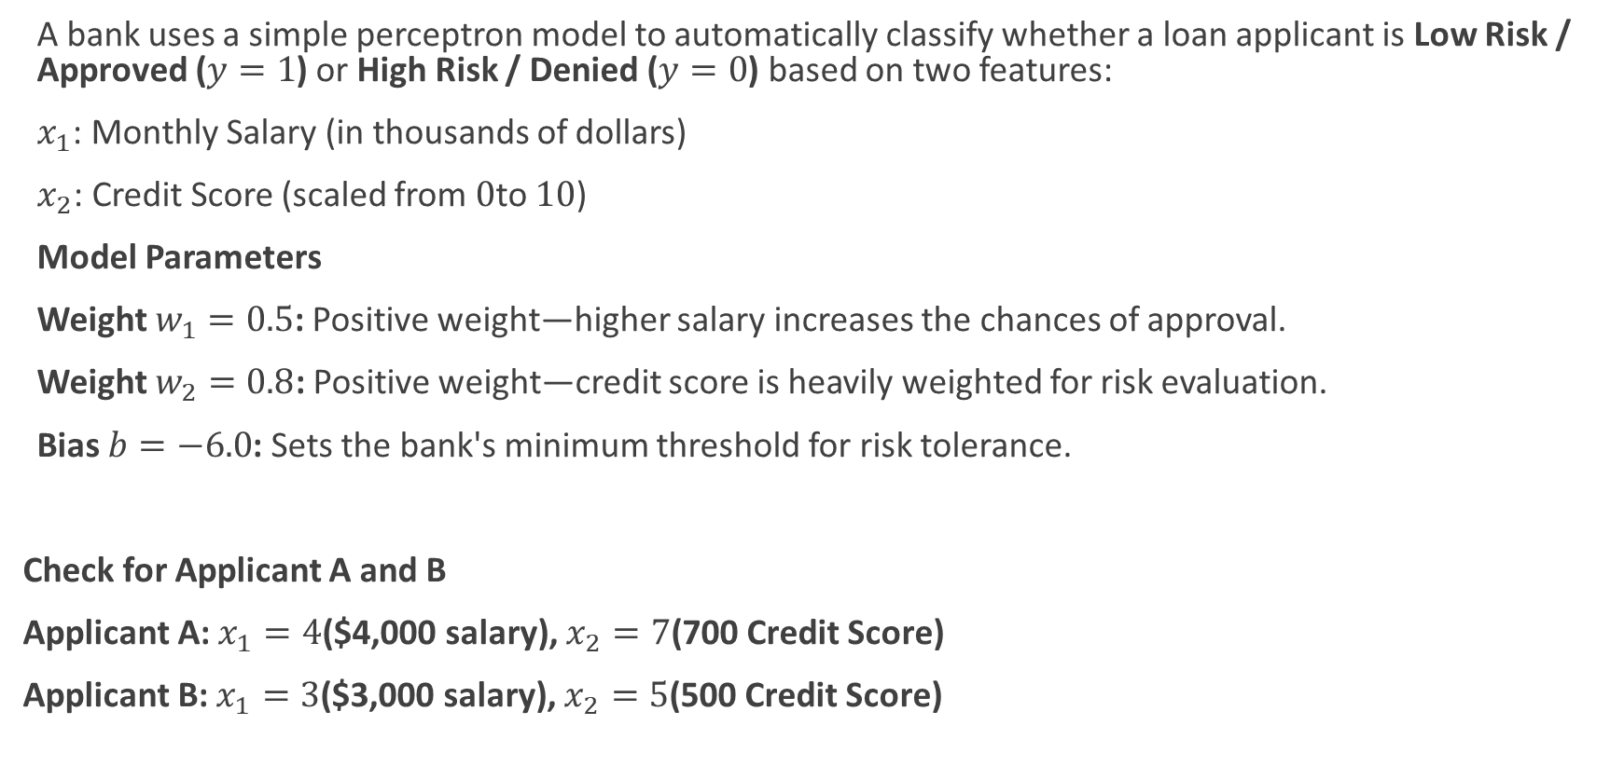
Question 2
A bank uses a simple perceptron model to automatically classify whether a loan applicant is Low Risk / Approved ($y=1$) or High Risk / Denied ($y=0$) based on two features:
$x_{1}$: Monthly Salary (in thousands of dollars)
$x_{2}$: Credit Score (scaled from $0$to $10$)
Model Parameters
Weight $w_{1}=0.5$: Positive weight—higher salary increases the chances of approval.
Weight $w_{2}=0.8$: Positive weight—credit score is heavily weighted for risk evaluation.
Bias $b=−6.0$: Sets the bank's minimum threshold for risk tolerance.
Check for Applicant A and B
Applicant A: $x_{1}=4$($4,000 salary), $x_{2}=7$(700 Credit Score)
Applicant B: $x_{1}=3$($3,000 salary), $x_{2}=5$(500 Credit Score)

Slide 47

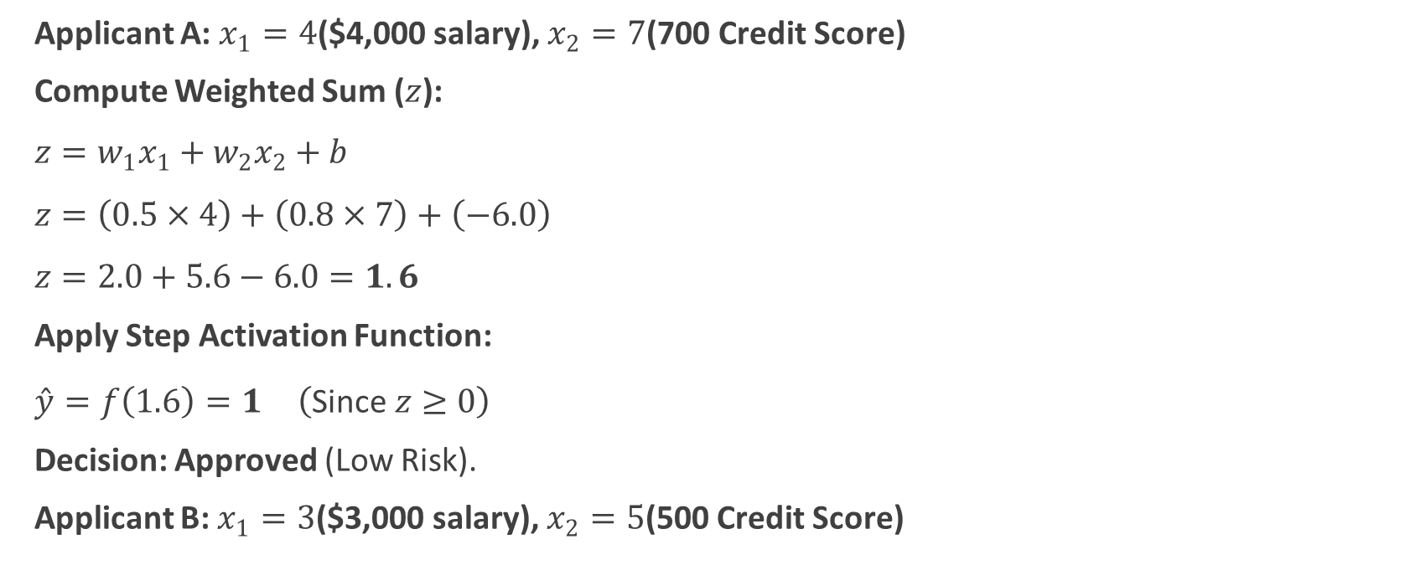
Applicant A: $x_{1}=4$($4,000 salary), $x_{2}=7$(700 Credit Score)
Compute Weighted Sum ($z$):
$z=w_{1}x_{1}+w_{2}x_{2}+b$
$z=\left(0.5×4\right)+\left(0.8×7\right)+\left(−6.0\right)$
$z=2.0+5.6−6.0=1.6$
Apply Step Activation Function:
$\overset{ˆ}{y}=f\left(1.6\right)=1 \left(\text{Since }z≥0\right)$
Decision: Approved (Low Risk).
Applicant B: $x_{1}=3$($3,000 salary), $x_{2}=5$(500 Credit Score)
Compute Weighted Sum ($z$):
$z=w_{1}x_{1}+w_{2}x_{2}+b$
$z=\left(0.5×3\right)+\left(0.8×5\right)+\left(−6.0\right)$
$z=1.5+4.0−6.0=−0.5$
Apply Step Activation Function:
$\overset{ˆ}{y}=f\left(−0.5\right)=0 \left(\text{Since }z<0\right)$
Decision: Denied (High Risk).

Slide 48
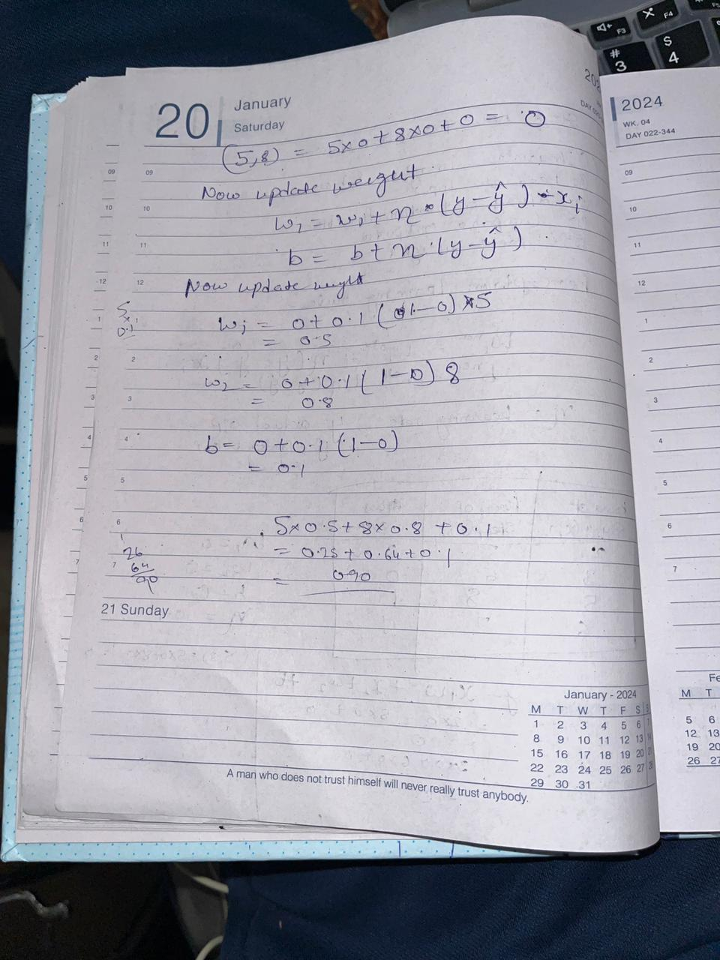
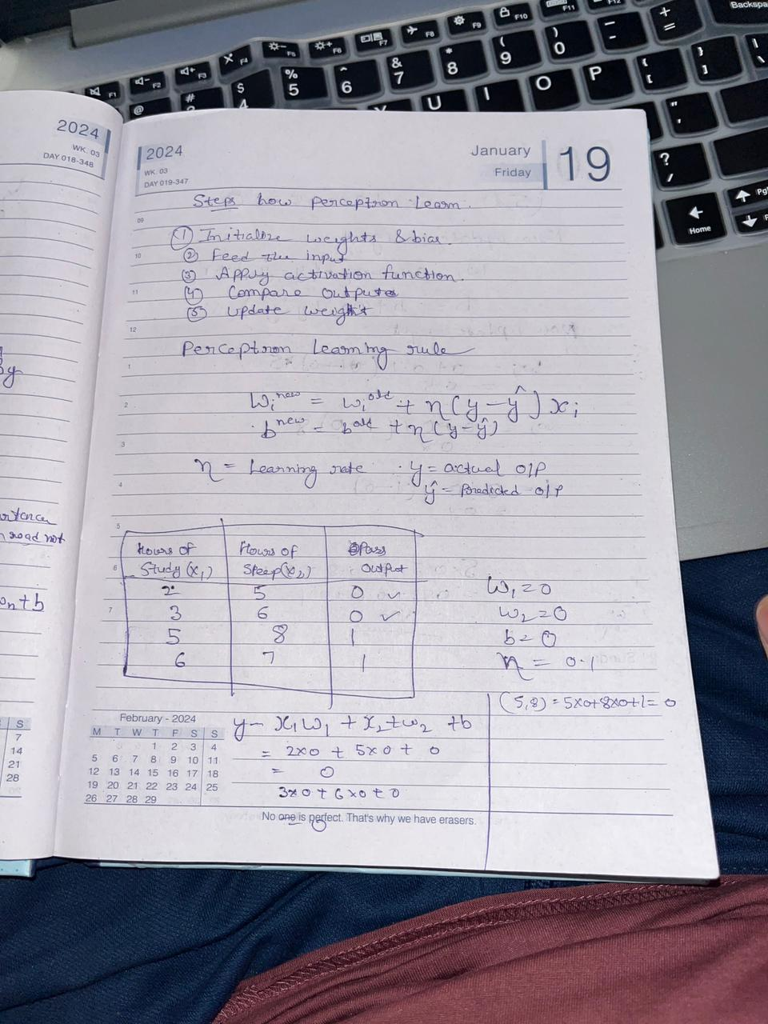

Slide 49


Slide 50
Artificial Neuron vs Perceptron
Aspect | Artificial Neuron | Perceptron
Nature | General model | Specific implementation
Activation function | Any function | Step function only
Output | Continuous or discrete | Binary (0 or 1)
Learning capability | Supports complex models | Limited to linear problems
Usage | Deep neural networks | Simple classification
Flexibility | High | Low

Slide 51
Artificial Neuron vs Perceptron Vs MCP neuron
Feature | MCP | Perceptron | Modern Artificial Neuron
Weight learning | No | Yes (Rule -based) | Yes (Gradient Based)
Activation | Step | Step | Flexible
Output | Binary | Binary | Continuous / nonlinear
Differentiable | NO | No | Yes
Deep learning support | No | No | Yes
Although an MCP neuron could theoretically adjust weights like a perceptron, learning is not defined in its original model, whereas the perceptron explicitly includes a rule-based weight update mechanism that learns without using differentiation or gradient descent.
MCP → artificial neuron without learning rule
Perceptron → artificial neuron with rule-based learning
Modern neuron → artificial neuron with gradient learning

Slide 52
Multilayer Artificial Neural Network (MLANN)
A multilayer artificial neural network (MLANN) is a computational model composed of multiple layers of artificial neurons, where each layer contains several interconnected neurons that collectively transform input data into meaningful output through weighted connections and nonlinear activation functions.
In simple words there are Many layers, Many neurons per layer and Fully interconnected for Learning complex patterns
Input layer: Receives raw input values, No processing, Just passes data forward.
Hidden layer(s): One or more intermediate layers with one or more neurons, Each neuron performs weighted sum + activation, Responsible for feature learning
Output layer: Produces final prediction like Classification or regression result
Interconnection concept: In a multilayer neural network, each neuron in one layer is typically connected to all neurons in the next layer; each connection has an associated weight that controls its influence, and each neuron includes a bias that shifts its activation.

Slide 53
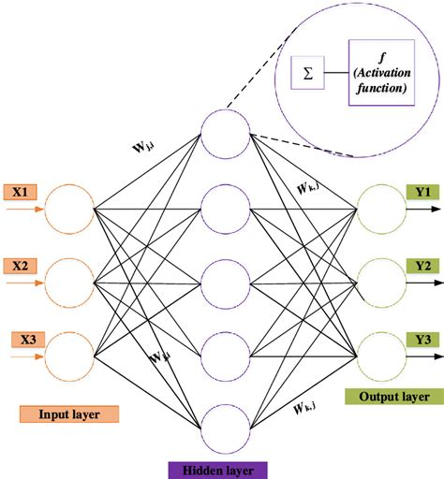
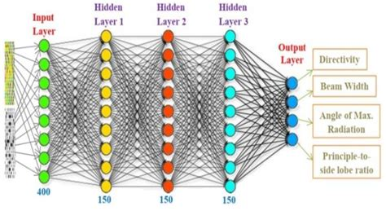
Multilayer Artificial Neural Network (MLANN)

Slide 54
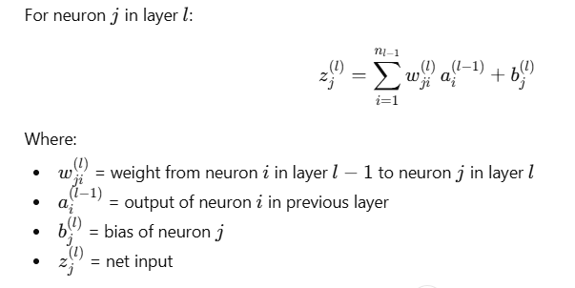



Generic mathematical formula for intermediate neuron in multilayer ANN
Consider: layer index → l, neuron index in that layer → j, neurons in previous layer → i
Weighted sum (pre-activation)
Activation
Where:
f(⋅)= activation function (ReLU, sigmoid, tanh, etc.)
Combined generic neuron formula
Matrix form (compact representation)
This is the standard forward propagation equation.

Slide 55
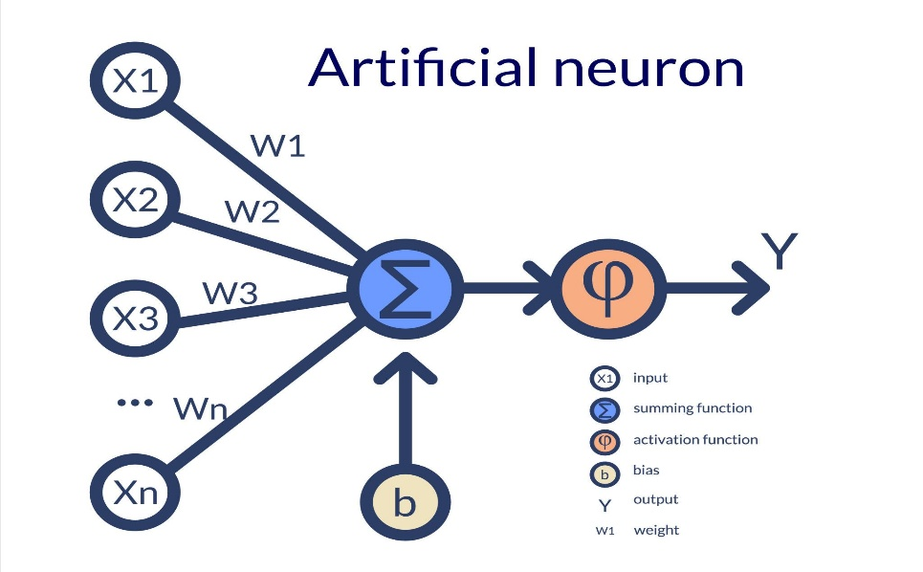



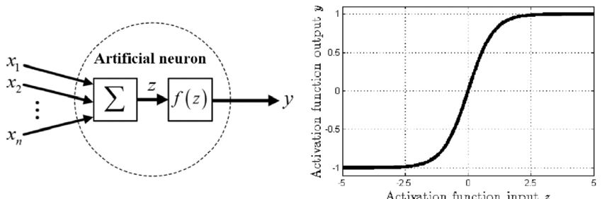


Single Artificial Neuron (ANN Model)
A single neuron mimics how biological neurons combine inputs and produce an output.
Given inputs:
with weights:
and bias b,
the neuron computes:
or in compact form:
Then activation is applied:
Sigmoid Activation Function

Slide 56
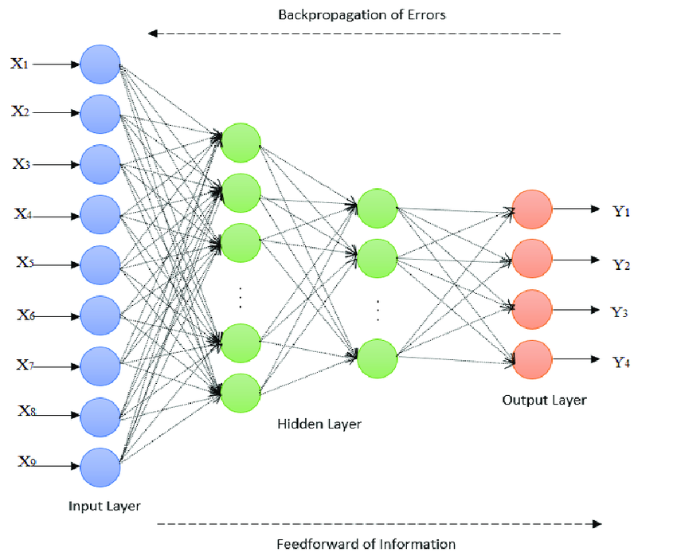
Multilayer ANN

Slide 57
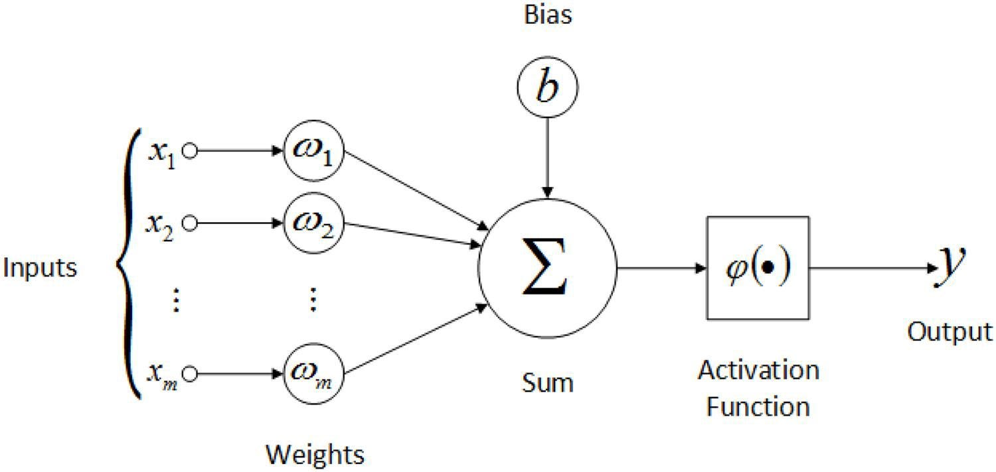


Multilayer ANN: Forward Propagation
Forward propagation is how data flows input → output.
Steps:
Multiply inputs with weights
Add bias
Apply activation
Produce prediction
Loss Function
Measures prediction error:
Goal:
  Minimize loss

Slide 58
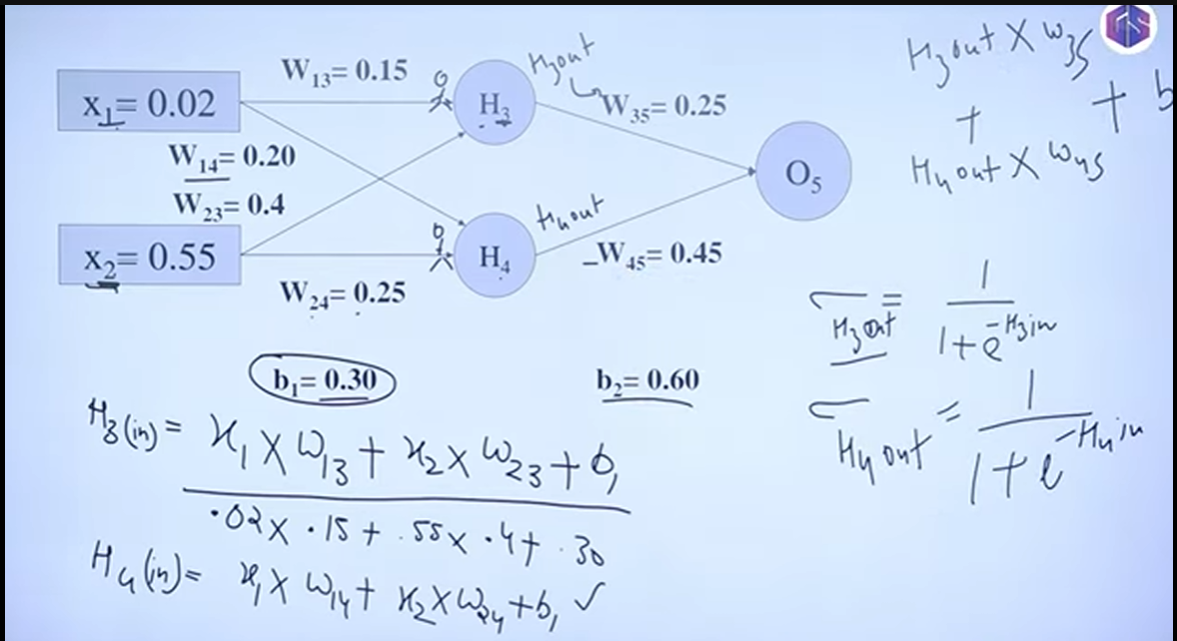

Slide 59
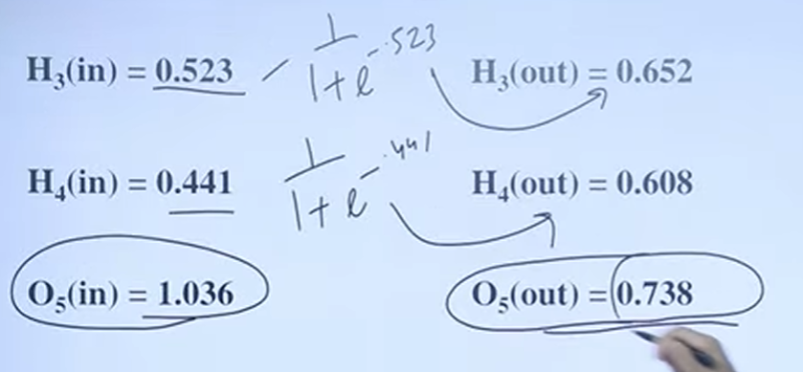

Slide 60
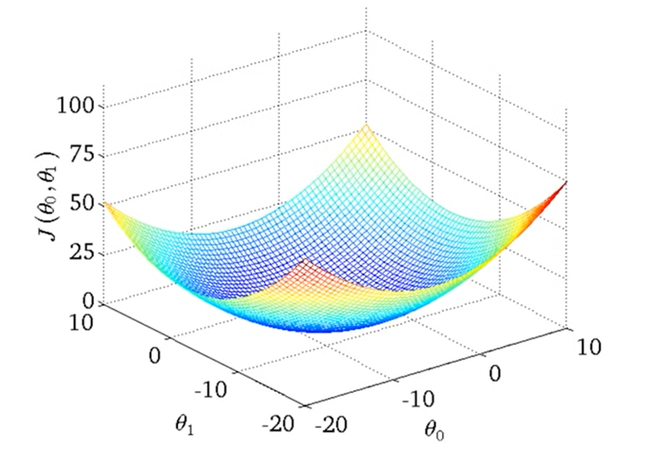
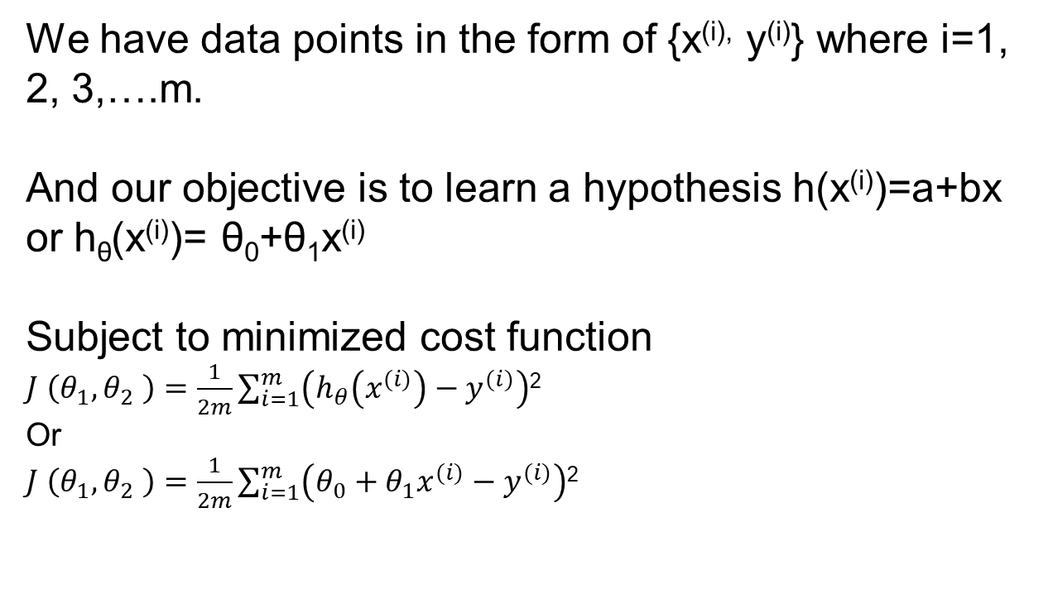
Gradient Descent Learning
We have data points in the form of {x^{(i),} y^{(i)}} where i=1, 2, 3,….m.
And our objective is to learn a hypothesis h(x^{(i)})=a+bx or h_{θ}(x^{(i)})= θ₀+θ₁x^{(i)}
Subject to minimized cost function
$J \left(θ_{1},θ_{2} \right)=\frac{1}{2m}\sum_{i=1}^{m}{\left(h_{θ}\left(x^{(i)}\right)−y^{(i)}\right)}$²
Or
$J \left(θ_{1},θ_{2} \right)=\frac{1}{2m}\sum_{i=1}^{m}{\left(θ_{0}+θ_{1}x^{(i)}−y^{(i)}\right)}$²

Slide 62
Algorithm
Have some function J(θ₀, θ₁)
Want to minimize min J(θ₀, θ₁)
Outline
Start with some θ₀, θ₁
Keep changing θ₀, θ₁ to reduce J(θ₀, θ₁) until we hopefully end up at a minimum.

Slide 63
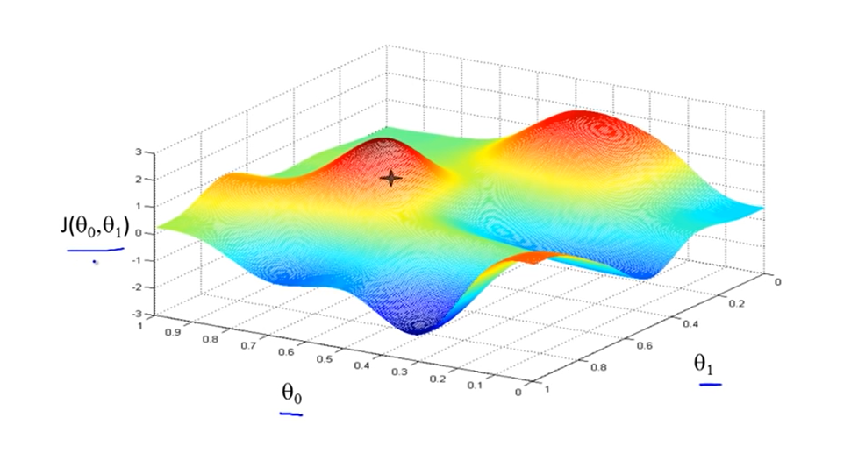

Slide 64
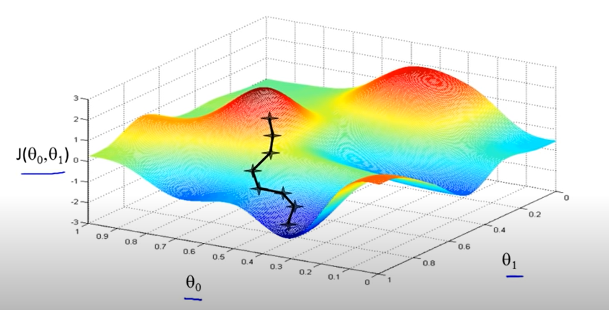

Slide 65
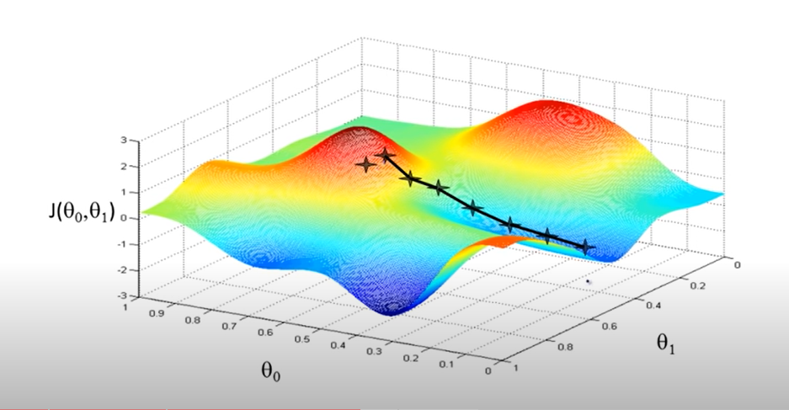

Slide 66
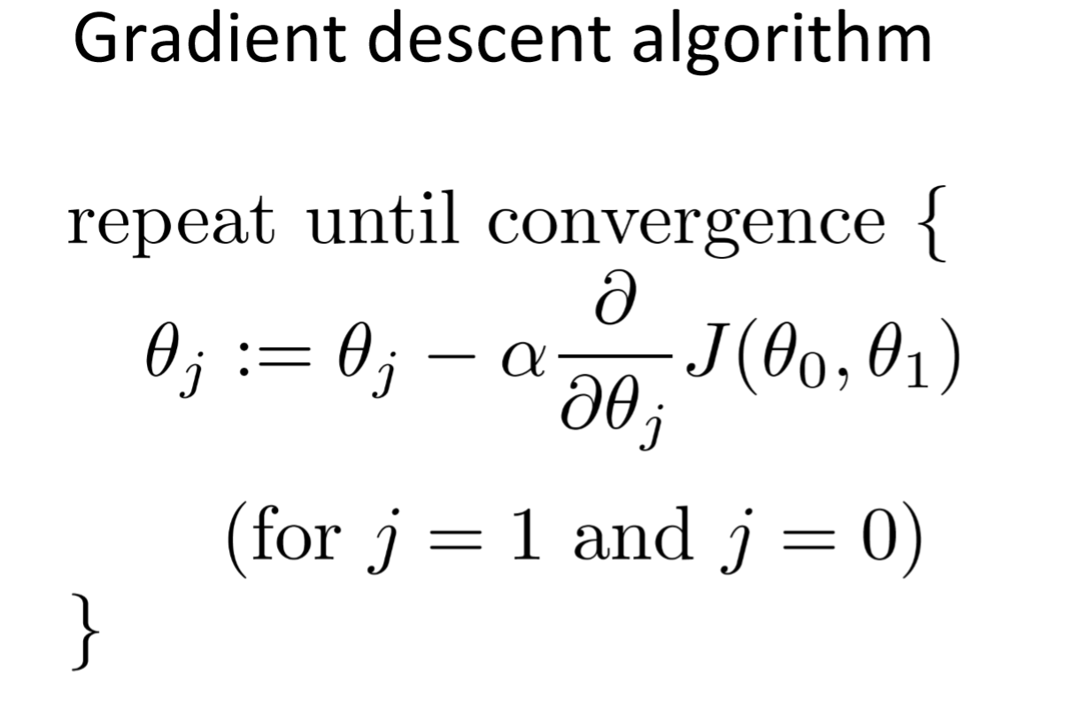
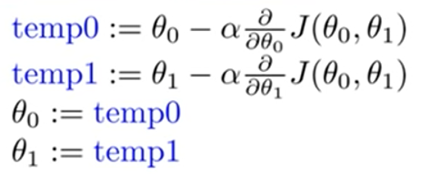
Correct Implementation of Gradient Descent Algorithm

Slide 67
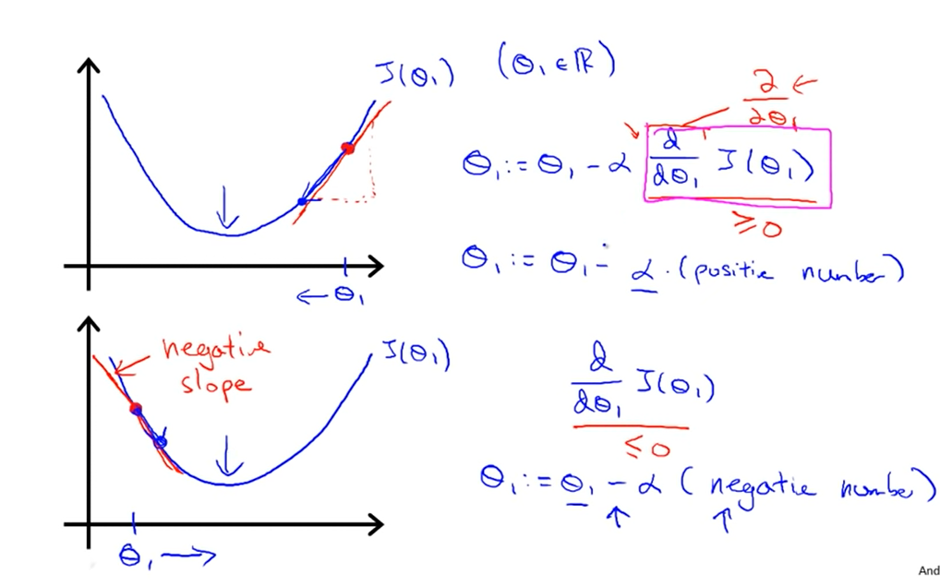

Slide 68
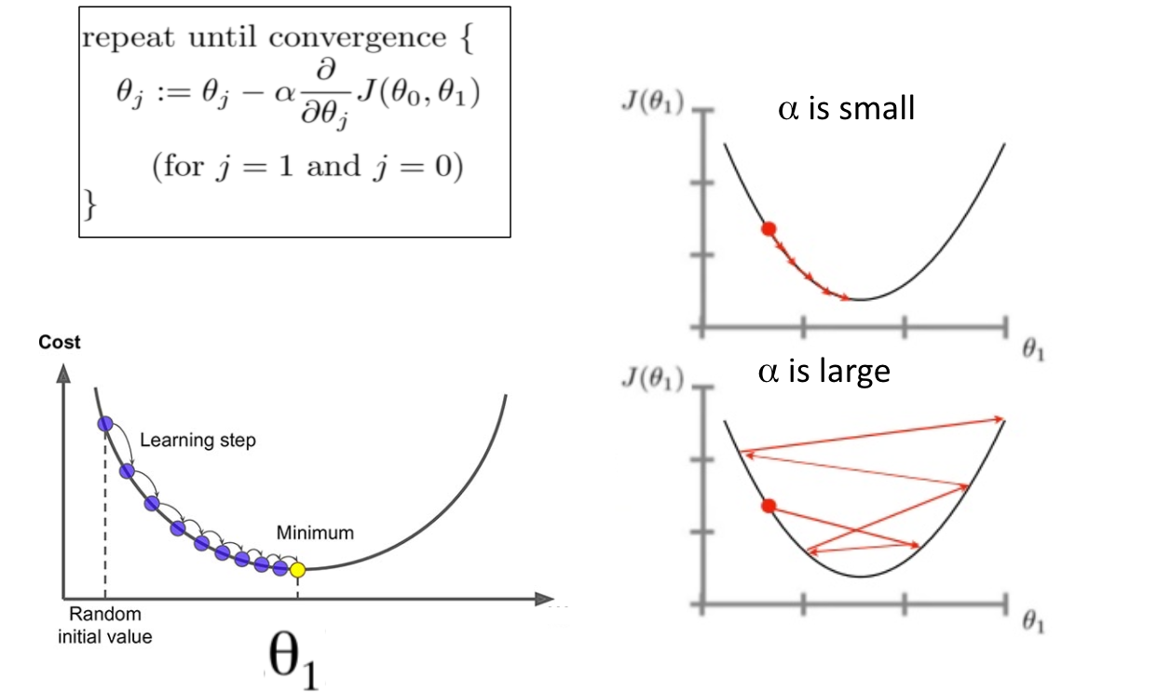

Slide 69
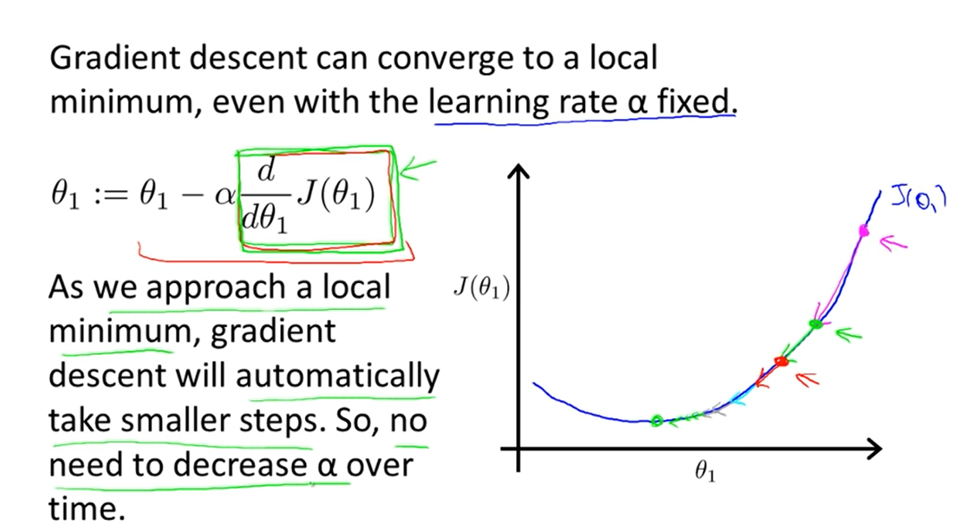

Slide 70

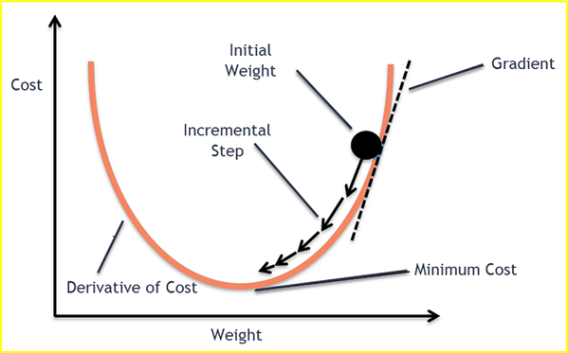
Gradient Descent Learning
Weights are updated to reduce loss.
Update rule:
Where:
η= learning rate
gradient = slope of error curve
Interpretation:
Positive slope → decrease weight
Negative slope → increase weight

Slide 71
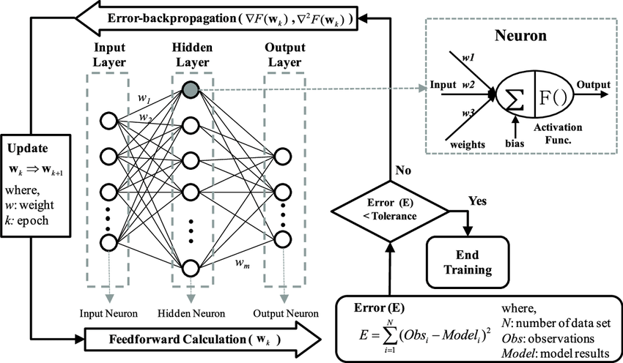
Backpropagation
Backpropagation answers one core question: “How much did each weight cause the prediction error?” Once we know that, we adjust weights to reduce error.
Process:
Compute loss
Find output error
Propagate backward
Update weights

Slide 72
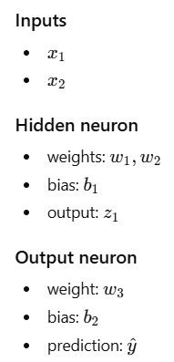
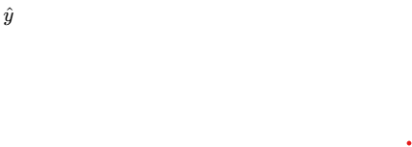

Example
Z1
x1
w1
x1
w3
x2
w2
b1
b2
Activation = linear
So:

Slide 73






Forward Propagation
Hidden neuron calculation
Weighted sum:
Since activation is linear:
So:
Output neuron calculation
Substitute a1:
Expand:
Loss Function
where:𝑦= true target

Slide 74






Gradient for Output Weight w3
We want:
Because:
Apply chain rule
First term
Second term
Combine

Slide 75


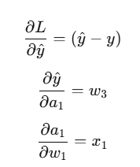

Gradient for Hidden Weight w1
We compute:
Chain rule expansion
Each term
Final gradient

Slide 76

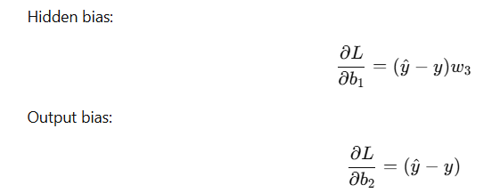
Gradient for Hidden Weight w2
We compute:
Bias Gradients

Slide 77




Weight and Bias Update
Update w3​
Update w1​
Update w2​
Bias updates

Slide 78
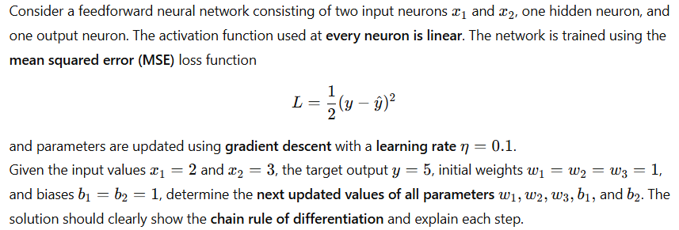
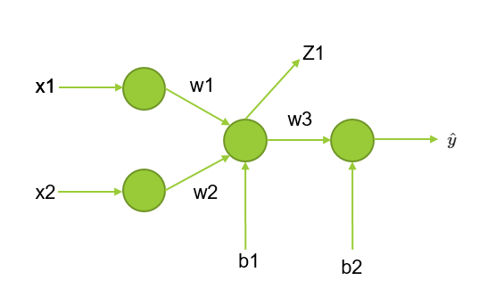
Numerical Problem

Slide 79





Numerical Problem
Step 1: Forward Propagation
Linear activation:
Output neuron
Prediction:

Slide 80


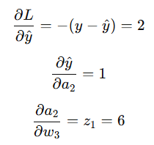




Numerical Problem
Step 2: Loss Value
Individual derivatives
Step 3: Gradients for Output Layer Parameters
Chain rule path
Chain rule expression
Final gradient

Slide 81



Numerical Problem
Chain rule

Slide 82





Numerical Problem
Step 4: Gradients for Hidden Layer Parameters
Dependency path
Chain rule
Final gradient

Slide 83





Numerical Problem
Dependency path
Full chain rule expression

Slide 84





Numerical Problem
Dependency path
Full chain rule expression
All other terms are identical to w2​.

Slide 85

Numerical Problem

Slide 86

Numerical Problem

Slide 87




Numerical Problem
Step 1: Forward Propagation
Sigmoid activation:
Output neuron
Sigmoid activation (prediction):

Slide 88



Numerical Problem
Step 2: Loss Value
Step 3: Useful Sigmoid Derivative

Slide 89



Numerical Problem
Step 4: Gradients for Output Layer
(A) Gradient of w3​
Complete chain rule
Individual terms

Slide 90


Numerical Problem
Gradient of b2​

Slide 91



Numerical Problem
Step 5: Gradients for Hidden Layer
Gradient of w1​
Complete chain rule

Slide 92


Numerical Problem
(D) Gradient of w2
Only the last term changes:
(E) Gradient of b1​

Slide 93

Numerical Problem

Slide 94



Chain Rule of Differentiation
Consider the following feed forward network
If suppose we want to update weight
W1 the for this the weight updating rule will be
So we compute:

Slide 95


Chain Rule of Differentiation
Chain Rule for w1

Slide 96


Chain Rule of Differentiation

Slide 97

Vanishing-gradient in Deep Neural Network
b1
b2
b3
b4
bn
w1
w2
w3
w4
wn
O/P
x1
O1
O2
O3
O4
On
Neurons are connected one after another, so dependency is
Where,
Each layer has sigmoid activation
Loss function is Mean Squared Error (MSE)

Slide 98


Vanishing-gradient in Deep Neural Network
Forward Pass (to understand dependency)
For clarity, write forward equations:
Loss:

Slide 99





Vanishing-gradient in Deep Neural Network
Suppose we want to update weight w1
Chain Rule of Differentiation (for weight w1​)
We need to compute
Full Chain Rule Expression
Expanding Each Term (Sigmoid Case)
Loss derivative
Sigmoid derivative

Slide 100




Vanishing-gradient in Deep Neural Network
Layer-to-layer derivative
Final Expanded Gradient if we see
Each sigmoid derivative ≤ 0.25
Chain rule = multiplication of many small numbers
Example (5 hidden layers):
So:

Slide 101


Vanishing-gradient in Deep Neural Network
Final Effect on Weight Update
Since:
In deep neural networks with sigmoid activation, the chain rule multiplies many small derivatives, causing gradients to vanish as they propagate backward through layers.
In deep neural networks, repeated multiplication of small derivatives during backpropagation causes gradients to approach zero, preventing effective learning in early layers.

Slide 102

Activation Functions
An activation function is a mathematical formula applied to the output of every neuron in a neural network layer.
a neuron first calculates a weighted sum of its inputs plus a bias ($z=w^{T}x+b$).
The activation function $f\left(z\right)$takes that raw score ($z$) and
transforms it into the neuron's final output signal ($a=f\left(z\right)$) before passing it to the next layer.
There are following activation functions are discussed:
  Sigmoid
  Tanh
  ReLU
  Leaky ReLU

Slide 103




Sigmoid Function
Formula:
Output Range:
0 to 1
Advantages:
Output is bounded between 0 and 1 (acts like probability).
Due to this biasness in output
Smooth gradient.
Clear prediction (close to 0 or 1).
Useful in binary classification output layer.
Disadvantages:
Not zero-centered (output always positive).
Vanishing gradient problem (for very large or very small values).
Uses exponential → computationally expensive.
Slow learning in deep networks.

Slide 104

Sigmoid Function numerical
Scenario: Email Spam Classifier
Suppose our model evaluates an email based on two extracted features:
$x_{1}$: Number of times the word "FREE" appears.
$x_{2}$: Number of times suspicious Links/URLs are present.
Model Parameters (Trained Weights & Bias)
$w_{1}=1.2$(Weight for word "FREE")
$w_{2}=1.5$(Weight for links count)
$b=−2.0$(Base threshold)
Classification Threshold: If $\text{Probability }P≥0.5$, classify as Spam ($1$); otherwise, Not Spam ($0$).
Check for:
Email A: Received email containing 3 "FREE"s and 2 Links ($x_{1}=3,x_{2}=2$)
Email B: Normal email containing 0 "FREE"s and 1 Link ($x_{1}=0,x_{2}=1$)

Slide 105

Sigmoid
Email A: Received email containing 3 "FREE"s and 2 Links ($x_{1}=3,x_{2}=2$)
Step 1: Calculate Linear Logit ($z$)
$z=w_{1}x_{1}+w_{2}x_{2}+b$
$z=\left(1.2×3\right)+\left(1.5×2\right)+\left(−2.0\right)$
$z=3.6+3.0−2.0=4.6$
Step 2: Apply Sigmoid Activation Function
$P\left(\text{Spam}\right)=σ\left(4.6\right)=\frac{1}{1+e^{−4.6}}$
Since $e^{−4.6}≈0.01005$:
$P\left(\text{Spam}\right)=\frac{1}{1+0.01005}=\frac{1}{1.01005}≈0.990 \left(99.0\%\right)$
Step 3: Decision Threshold
Since $P=0.990≥0.5$, the email is classified as Spam ($1$).

Slide 106

Sigmoid
Email B: Normal email containing 0 "FREE"s and 1 Link ($x_{1}=0,x_{2}=1$)
Step 1: Calculate Linear Logit ($z$)
$z=\left(1.2×0\right)+\left(1.5×1\right)+\left(−2.0\right)$
$z=0+1.5−2.0=−0.5$
Step 2: Apply Sigmoid Activation Function
$P\left(\text{Spam}\right)=σ\left(−0.5\right)=\frac{1}{1+e^{−\left(−0.5\right)}}=\frac{1}{1+e^{0.5}}$
Since $e^{0.5}≈1.6487$:
$P\left(\text{Spam}\right)=\frac{1}{1+1.6487}=\frac{1}{2.6487}≈0.377 \left(37.7\%\right)$
Step 3: Decision Threshold
Since $P=0.377<0.5$, the email is classified as Not Spam / Inbox ($0$).

Slide 107


Tanh Function
Formula:
Output Range: -1 to +1
Advantages:
Zero-centered output.
Stronger gradients than sigmoid.
Vanishing gradient problem reduced (but not fully solved).
Often used in hidden layers.
Disadvantages:
Still suffers from vanishing gradient in deep networks.
Uses exponential → computationally costly.
Saturates at extreme values.

Slide 108

Tanh Function Example
Suppose a single-neuron model evaluates customer product reviews based on two extracted features:
$x_{1}$: Count of positive words (e.g., "excellent", "love")
$x_{2}$: Count of negative words (e.g., "terrible", "broken")
Model Parameters
$w_{1}=+1.5$(Weight for positive words)
$w_{2}=−2.0$(Weight for negative words)
$b=0.0$(Neutral baseline)
Check Positive or Negative Statement:
Review A: "Great product, I love it!" ($x_{1}=2\text{ positive words},x_{2}=0\text{ negative words}$)
Review B: "Arrived broken and terrible quality." ($x_{1}=0\text{ positive words},x_{2}=2\text{ negative words}$)

Slide 109

Review A: "Great product, I love it!" ($x_{1}=2\text{ positive words},x_{2}=0\text{ negative words}$)
Step 1: Calculate Linear Combination ($z$)
$z=w_{1}x_{1}+w_{2}x_{2}+b$
$z=\left(1.5×2\right)+\left(−2.0×0\right)+0.0=+3.0$
Step 2: Apply Tanh Activation Function
$\tanh\left(3.0\right)=\frac{e^{3.0}−e^{−3.0}}{e^{3.0}+e^{−3.0}}$
Since $e^{3.0}≈20.0855$and $e^{−3.0}≈0.0498$:
$\tanh\left(3.0\right)=\frac{20.0855−0.0498}{20.0855+0.0498}=\frac{20.0357}{20.1353}≈+0.995$
Output (+0.995): Strongly Positive Sentiment.

Slide 110

Review B: "Arrived broken and terrible quality." ($x_{1}=0\text{ positive words},x_{2}=2\text{ negative words}$)
Step 1: Calculate Linear Combination ($z$)
$z=\left(1.5×0\right)+\left(−2.0×2\right)+0.0=−4.0$
Step 2: Apply Tanh Activation Function
$\tanh\left(−4.0\right)=\frac{e^{−4.0}−e^{−\left(−4.0\right)}}{e^{−4.0}+e^{−\left(−4.0\right)}}=\frac{e^{−4.0}−e^{4.0}}{e^{−4.0}+e^{4.0}}$
Since $e^{4.0}≈54.598$and $e^{−4.0}≈0.0183$:
$\tanh\left(−4.0\right)=\frac{0.0183−54.598}{0.0183+54.598}=\frac{−54.5797}{54.6163}≈−0.999$
Output (-0.999): Strongly Negative Sentiment.

Slide 111



ReLU (Rectified Linear Unit)
Formula:
Output Range: 0 to ∞
Advantages:
Very simple and fast.
No exponential calculation.
Solves vanishing gradient problem (for positive inputs).
Computationally efficient.
Widely used in deep networks.
Disadvantages:
Dead ReLU problem (if input ≤ 0, gradient = 0).
Not zero-centered.
Neurons may stop learning if stuck in negative region.
Case 1: Strong Feature Presence ($x_{1}=3,x_{2}=1$)
Case 2: Weak / No Feature ($x_{1}=1,x_{2}=3$)

Slide 112

ReLU Example
Case 1: Strong Feature Presence ($x_{1}=3,x_{2}=1$)
Step 1: Compute Linear Combination ($z$)
$z=w_{1}x_{1}+w_{2}x_{2}+b$
$z=\left(2.0×3\right)+\left(−1.5×1\right)+\left(−1.0\right)=6.0−1.5−1.0=+3.5$
Step 2: Apply ReLU Activation
$f\left(3.5\right)=\max\left(0,3.5\right)=+3.5$
Output: $3.5$(The feature is detected; activation passes through completely uncompressed).
Case 2: Weak / No Feature ($x_{1}=1,x_{2}=3$)
Step 1: Compute Linear Combination ($z$)
$z=\left(2.0×1\right)+\left(−1.5×3\right)+\left(−1.0\right)=2.0−4.5−1.0=−3.5$
Step 2: Apply ReLU Activation
$f\left(−3.5\right)=\max\left(0,−3.5\right)=0.0$
Output: $0.0$(The feature is absent; the neuron remains completely deactivated).

Slide 113



Leaky ReLU
Formula:
Output Range: (-∞ to ∞)
Advantages:
Solves Dead ReLU problem.
Small gradient for negative inputs.
Computationally efficient.
Better learning than standard ReLU.
Disadvantages:
Slope (0.01) is manually chosen.
Still not fully zero-centered.
Performance depends on chosen leakage parameter.

Slide 114

Example Leaky ReLU
(1,3)

Slide 115

Example Leaky ReLU

